Slide 1
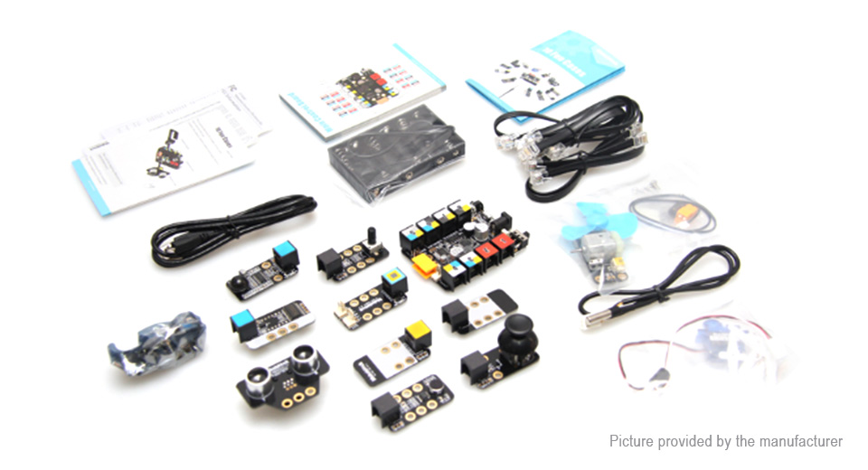
Electronics Sensors

Slide 2
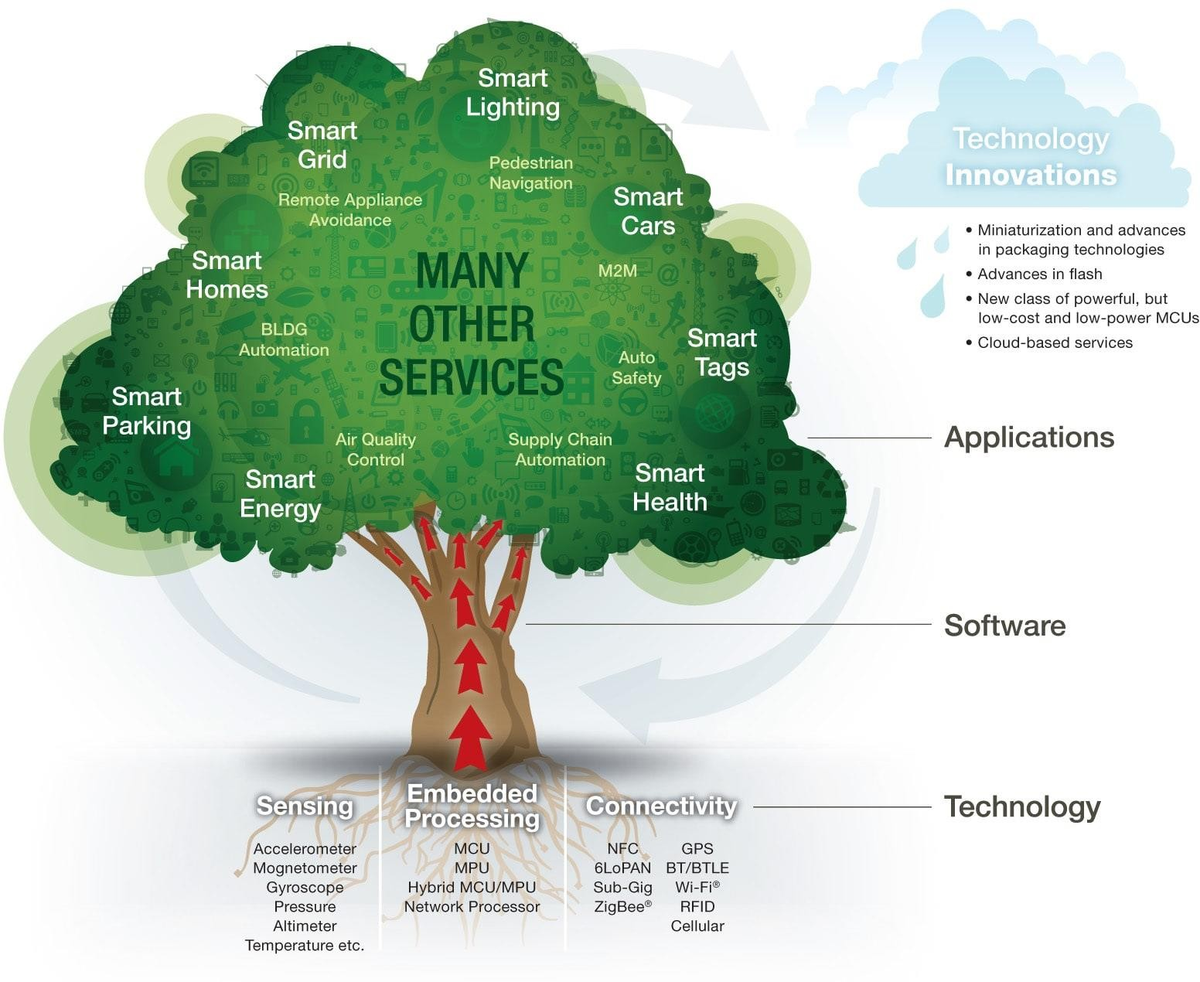

Slide 3

Why do we Need Sensors?
What can be Sensed?
What Sensors are Out There?
What can They do?
How Much do They Cost?
How Easy are They to Use?

Slide 4
Provides “awareness” of surroundings
What’s ahead, around, “out there”?
Allows interaction with environment
Robot lawn mower can “see” cut grass
Protection & Self-Preservation
Safety, Damage Prevention, Stairwell sensor
Gives the machine capability to goal- seek
Find colorful objects, seek goals
Makes things “interesting”

Slide 5

Light
Presence, color, intensity, content (mod), direction
Sound
Presence, frequency, intensity, content (mod),
direction
Heat
Temperature, wavelength, magnitude, direction
Chemicals
Presence, concentration, identity, etc.
Object Proximity
Presence/absence, distance, bearing, color, etc.
Physical orientation/attitude/position
Magnitude, pitch, roll, yaw, coordinates, etc.

Slide 6

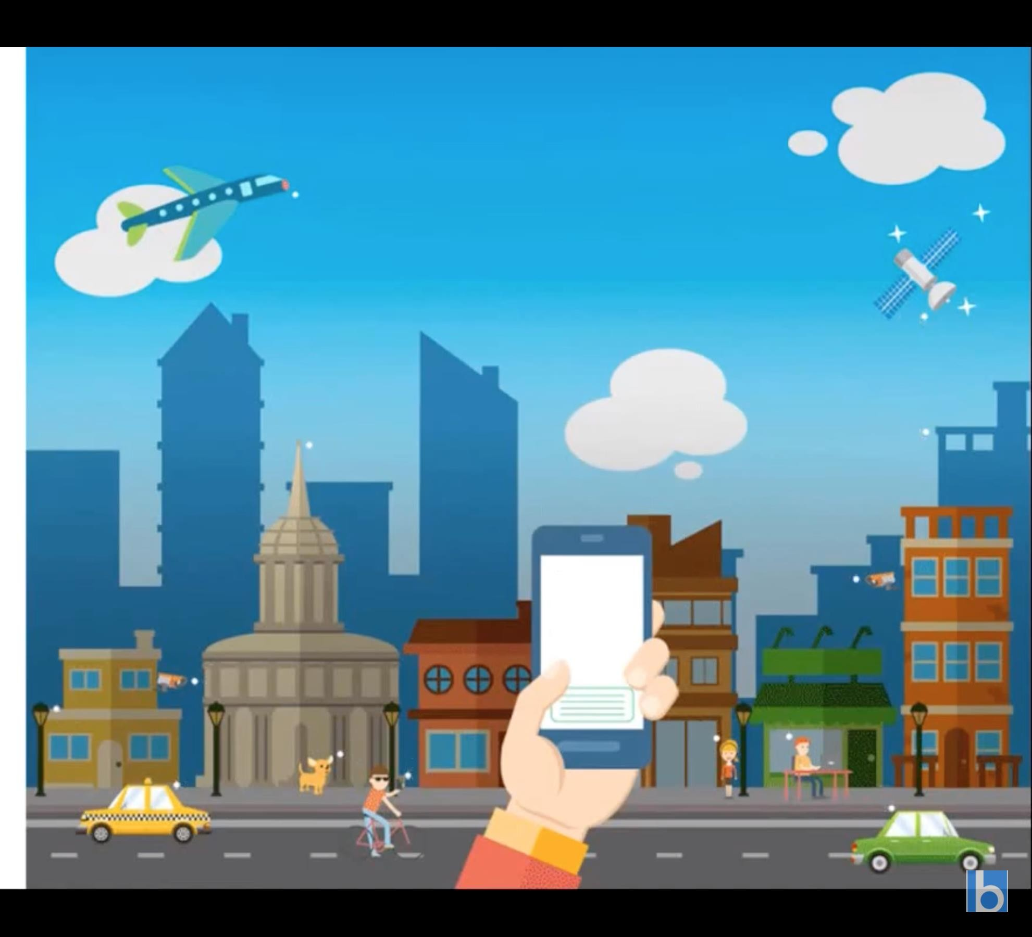

How many sensors are there in this image?

Slide 7
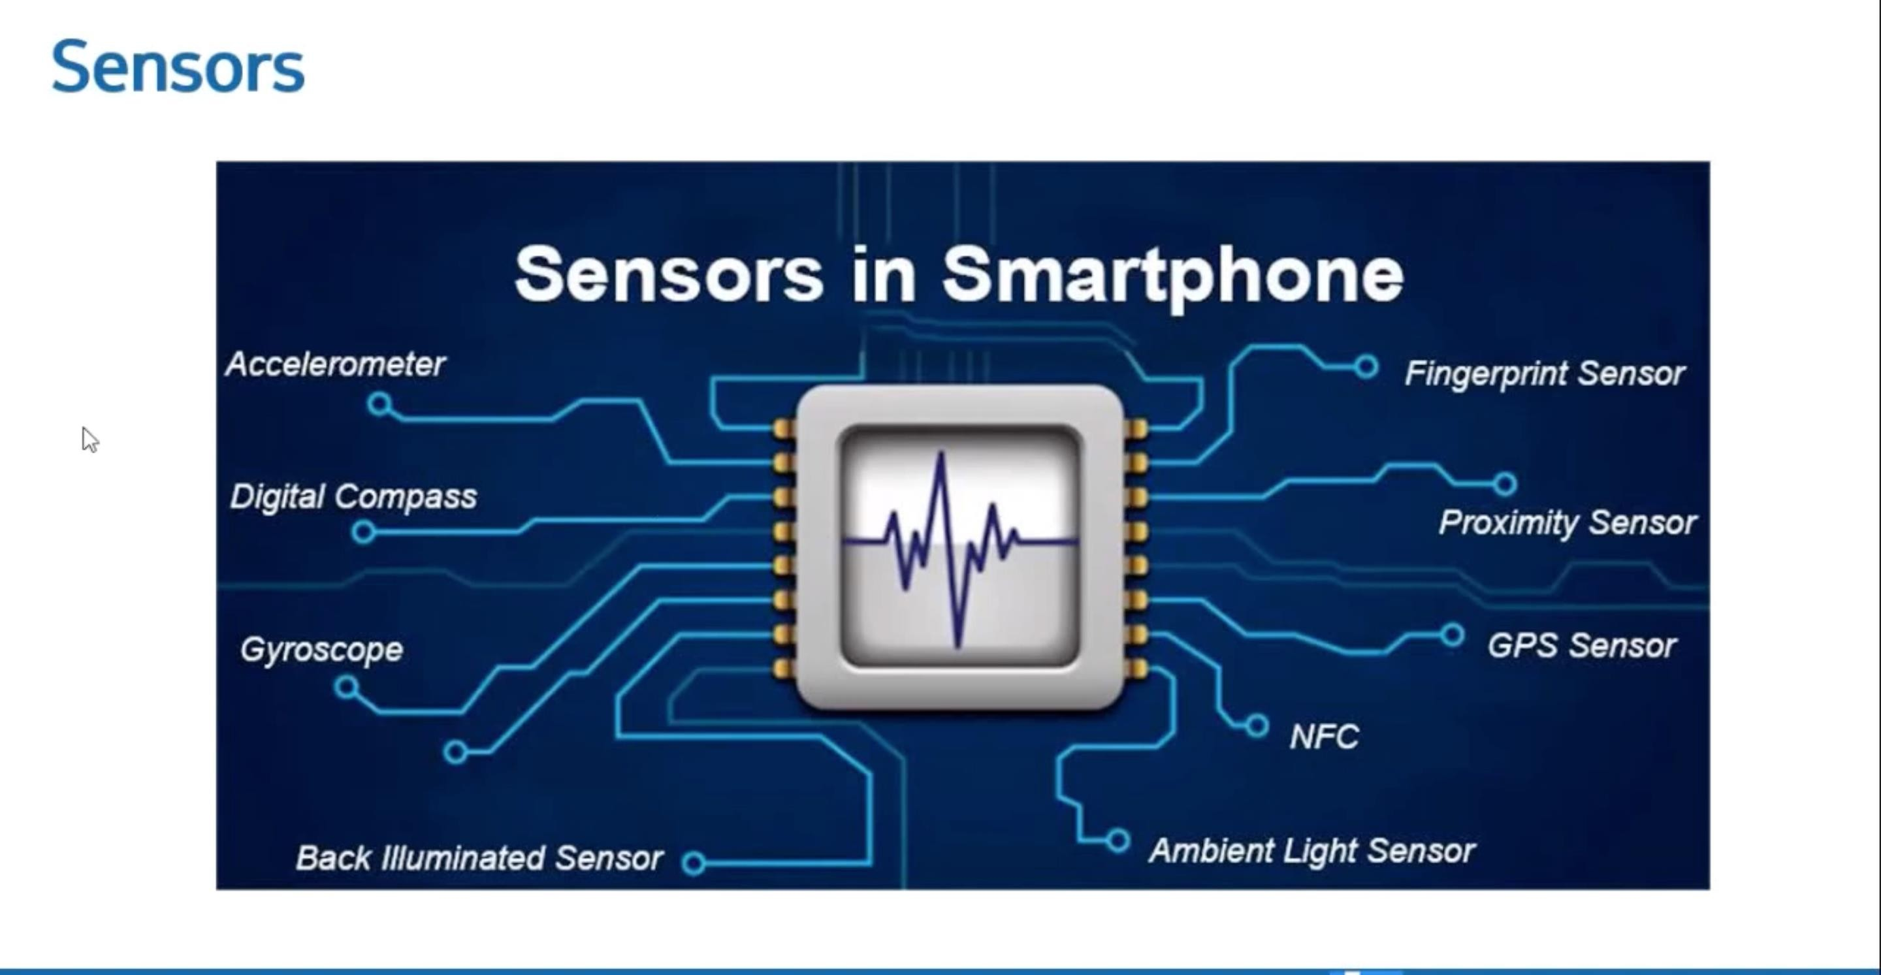

Slide 8
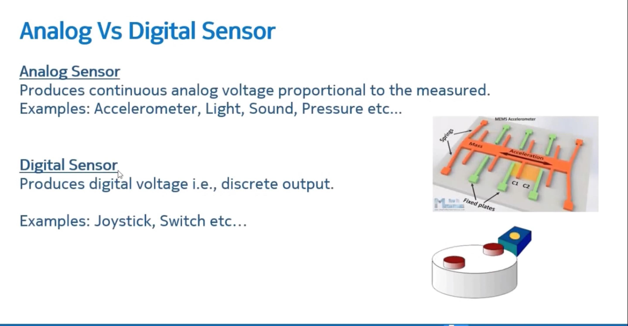

Slide 9
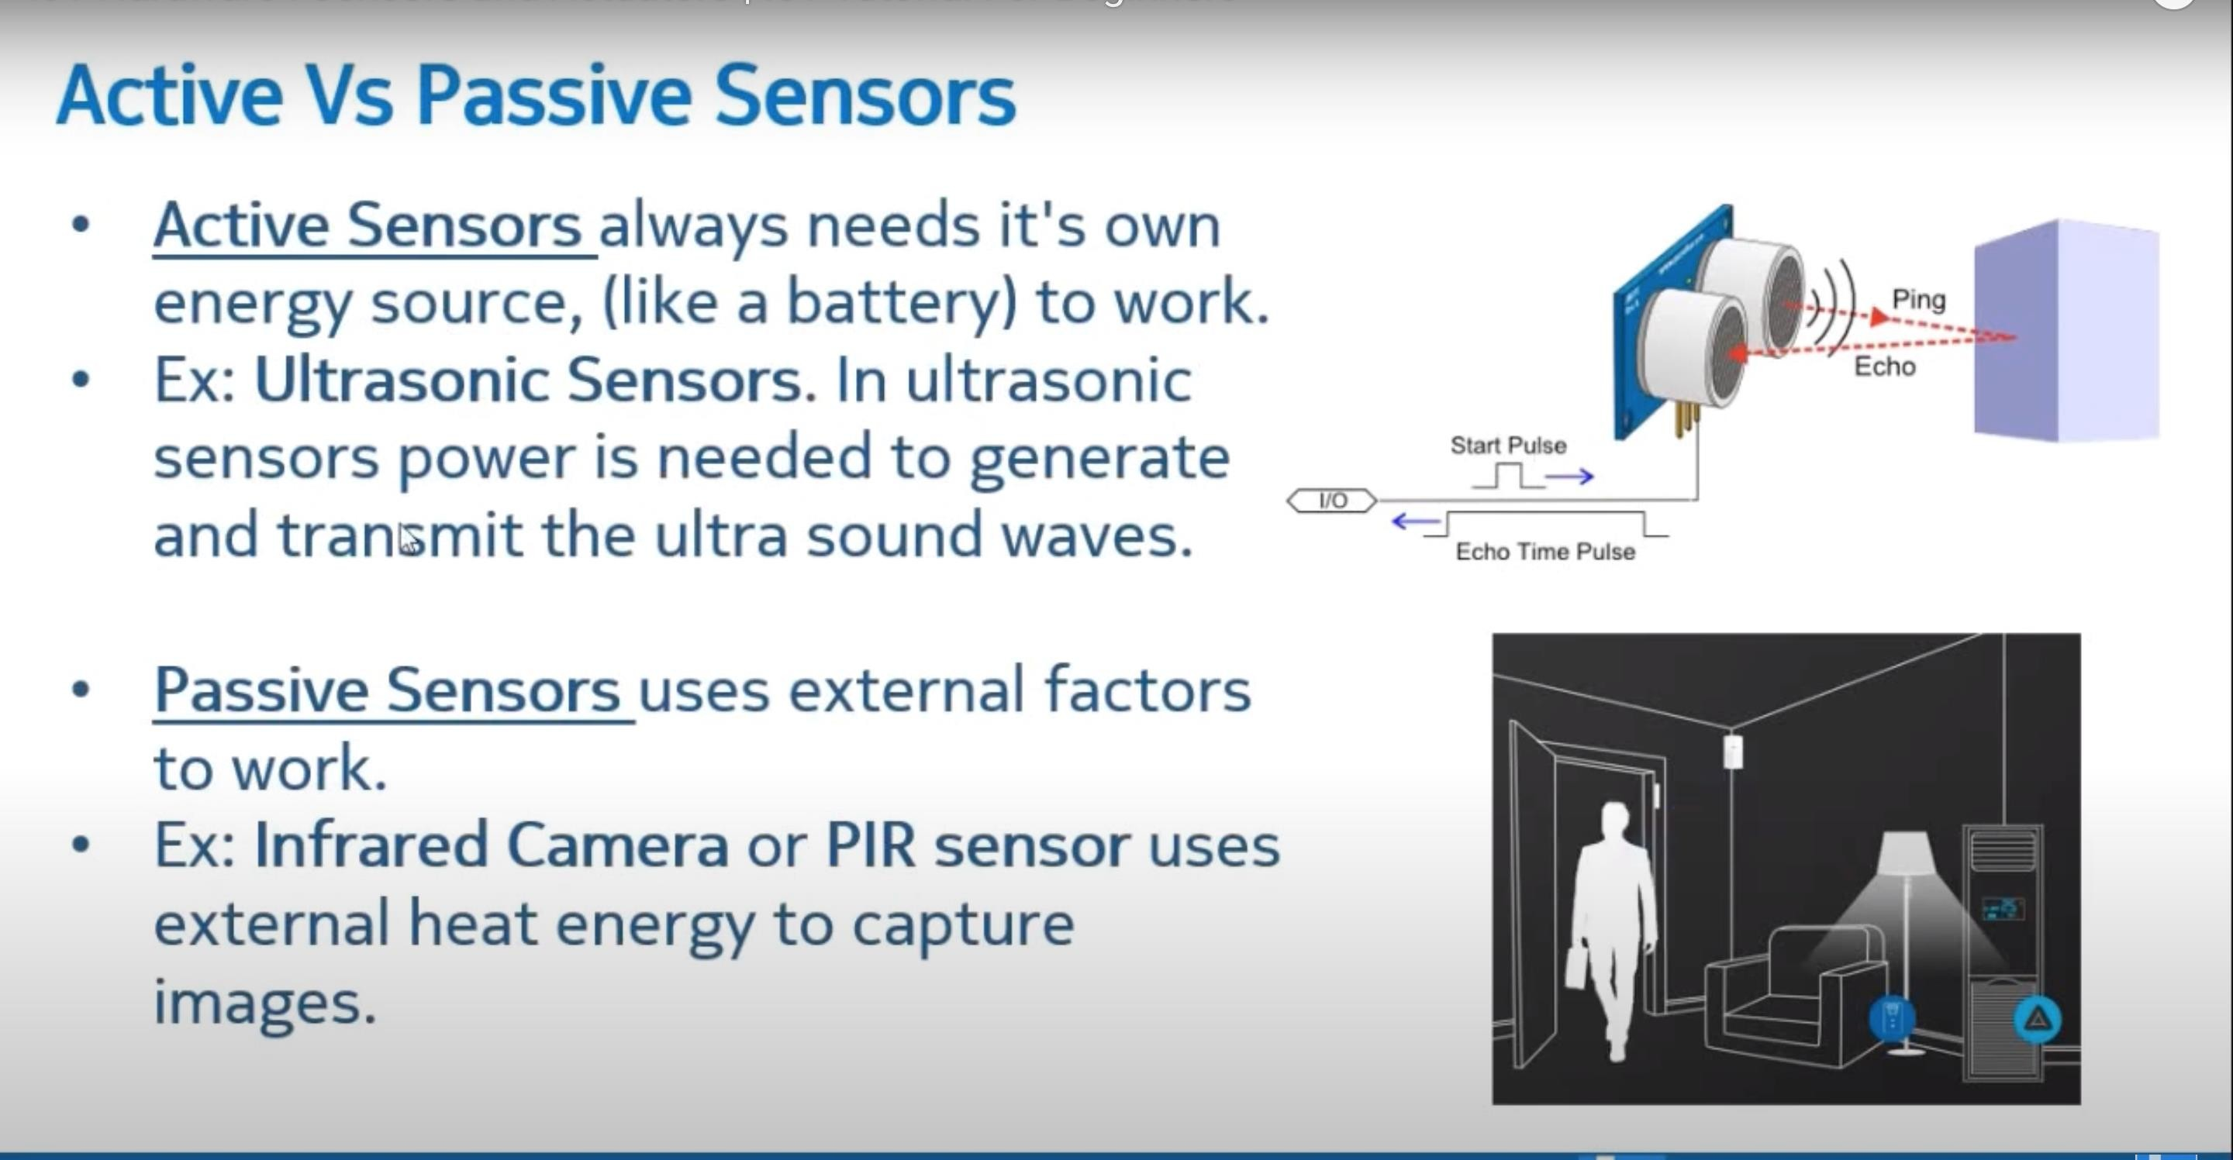

Slide 10
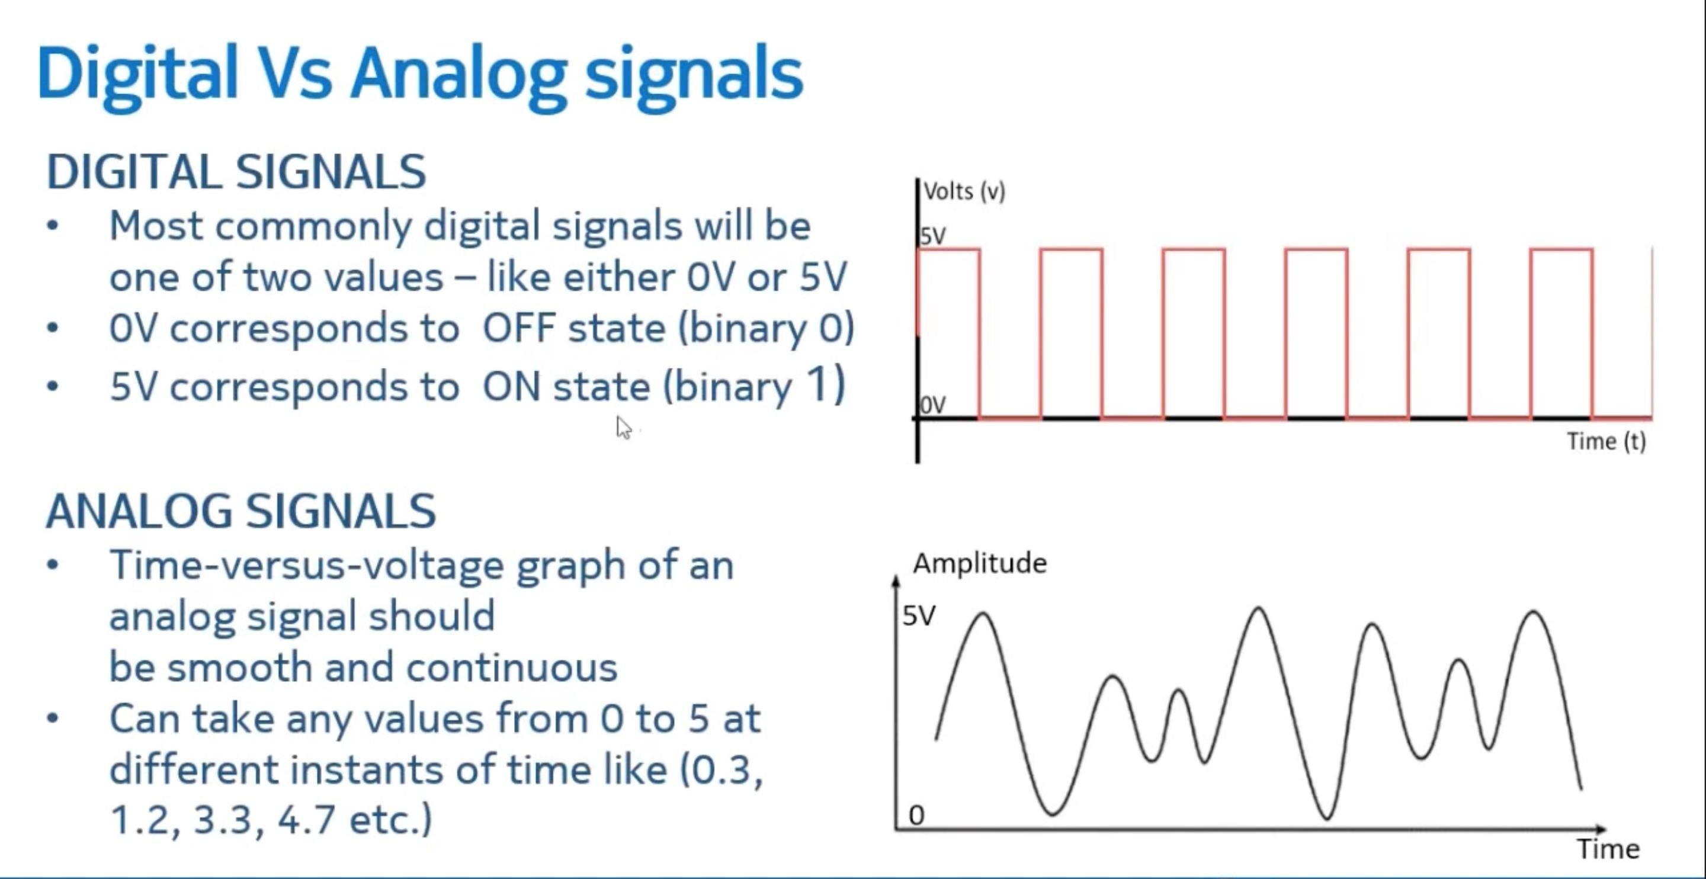

Heshan_Pathum
2020-11-09 00:08:15
--------------------------------------------
Cycle Time Same shape to same shape

Slide 11
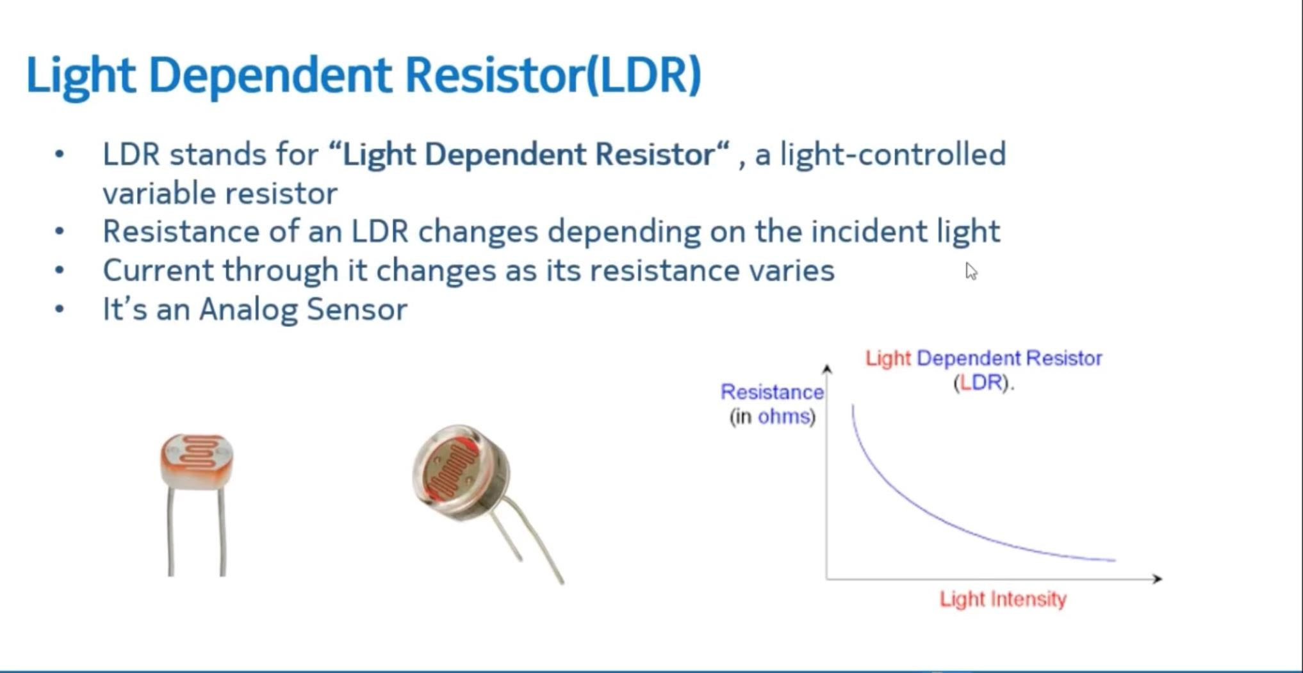

Slide 12
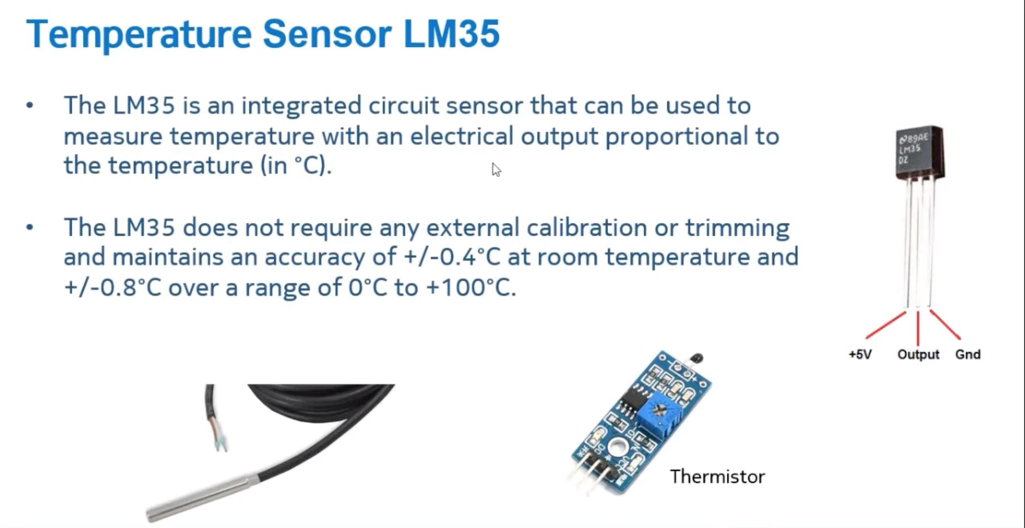




Slide 13
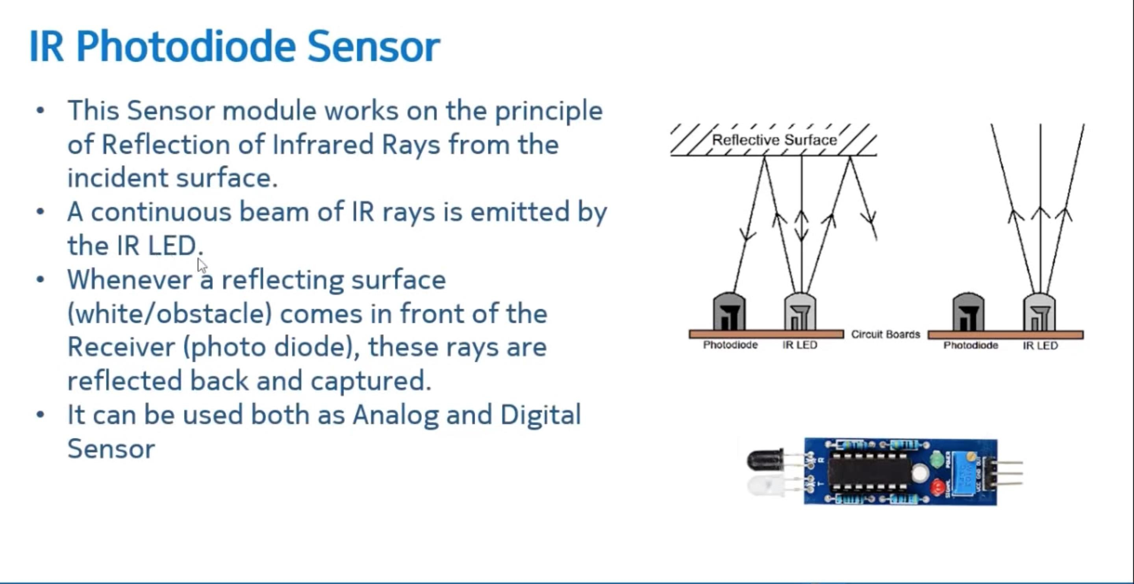

Slide 14


Active (emitting)
Oscillator generates IR reflections off objects
Filtered receiver looks for “reflections”
Pulses may be encoded for better discrimination
Typically frequencies around 40KHz
Doesn’t work well with dark, flat colored objects
Passive (sensor only)
Pyro-electric (heat sensor)
Look for IR emissions from people & animals
Used in security systems & motion detectors

Slide 15
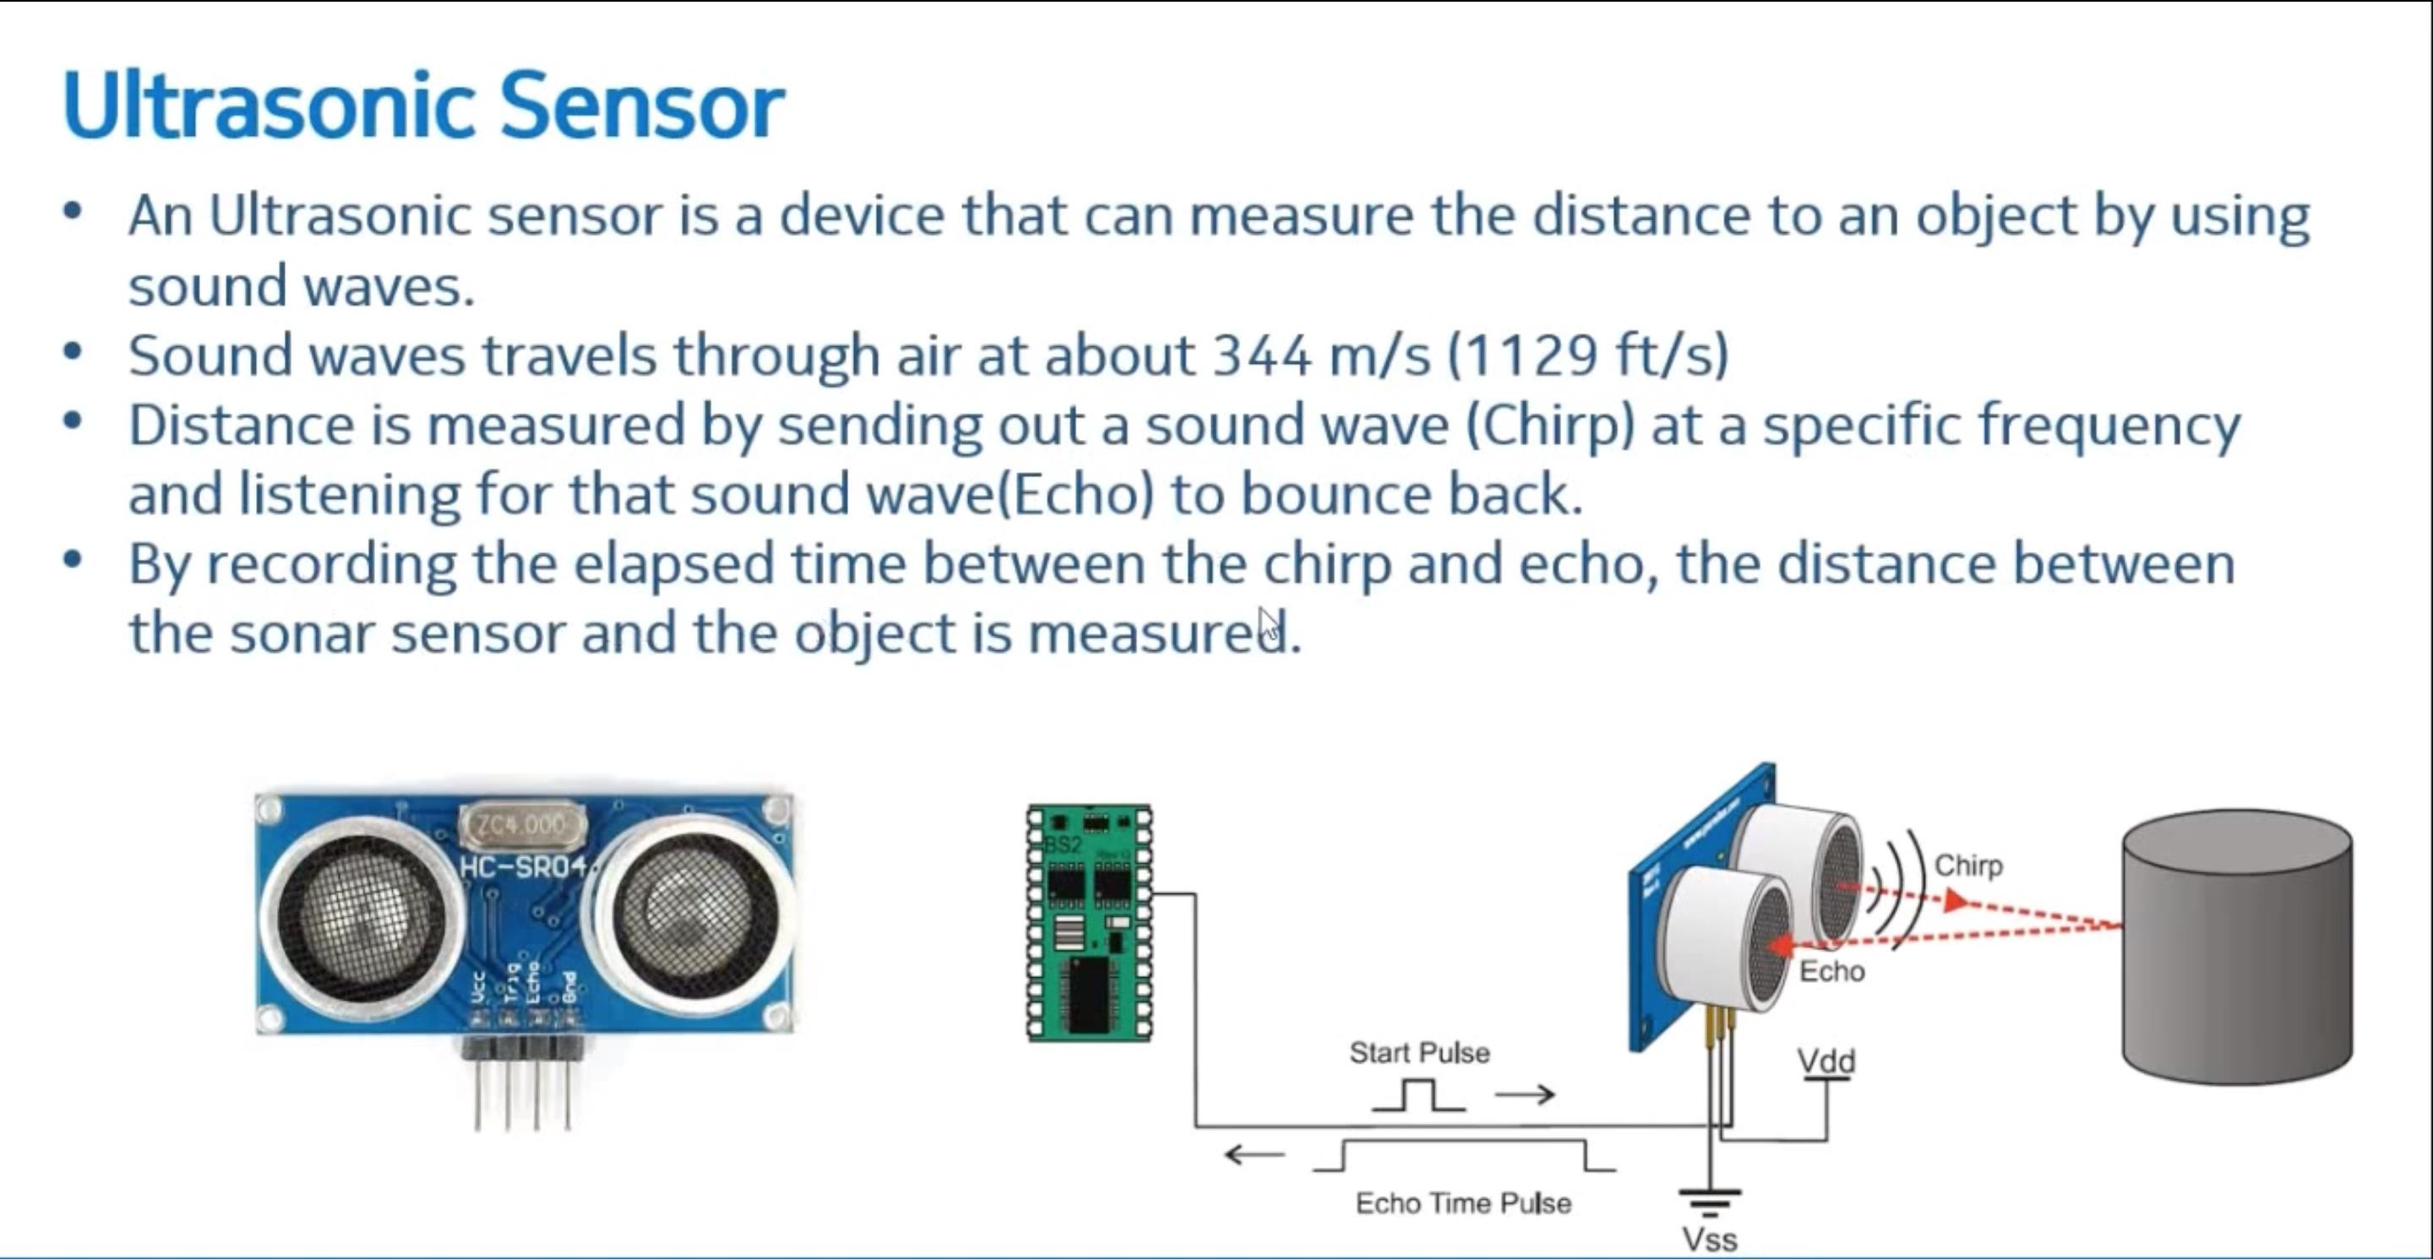

Slide 16
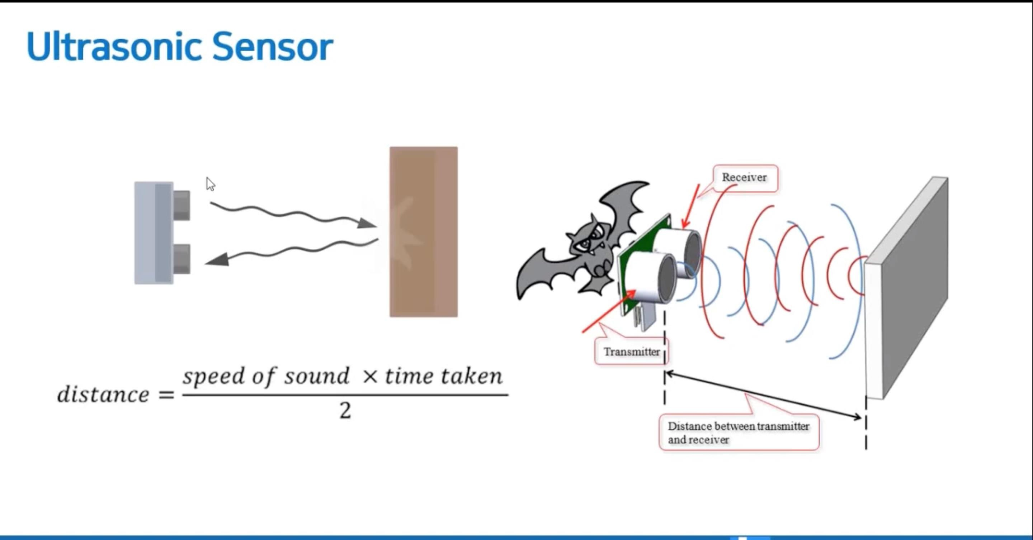

Slide 17
Beacon3
Beacon1
Sound Pulse
Sound Pulse
Light Pulse
Light Pulse
Robot
Sound Pulse
BEACON
RF Receiver IR Emitter
Ultrasonic Emitter
ROBOT
RF Transmitter IR Receiver
Ultrasonic Receiver
Light Pulse
Beacon2

Slide 18
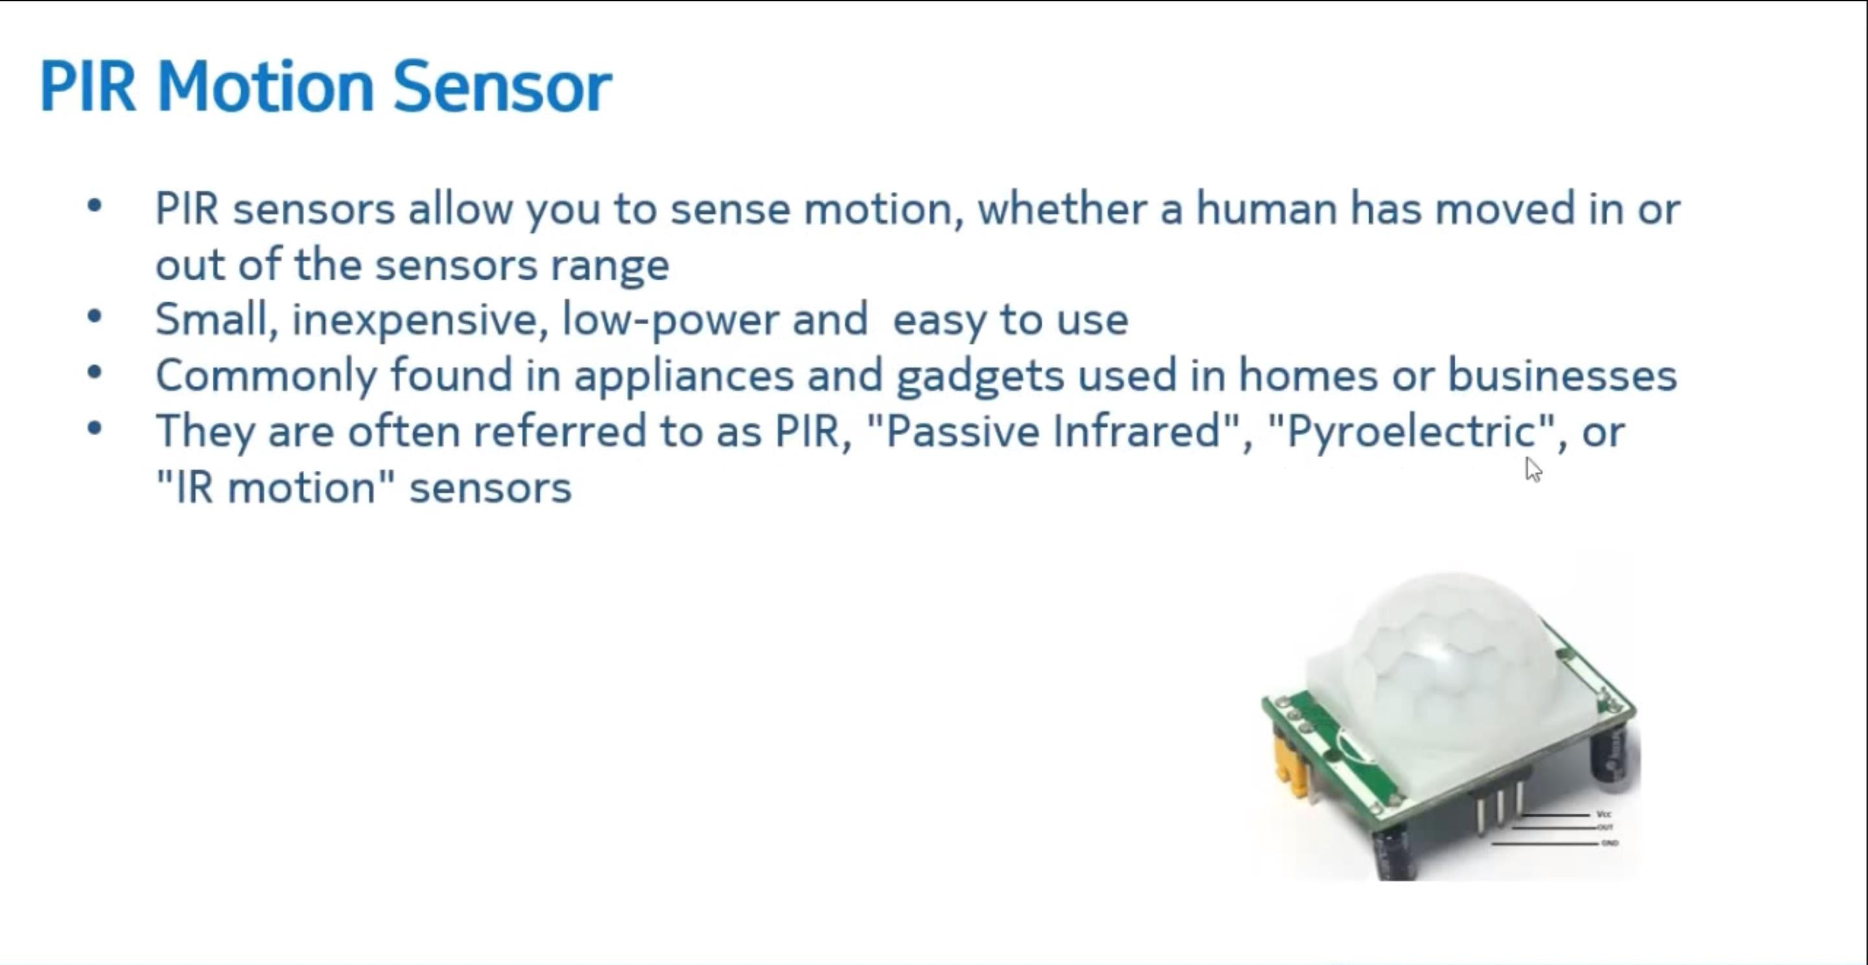

Slide 19
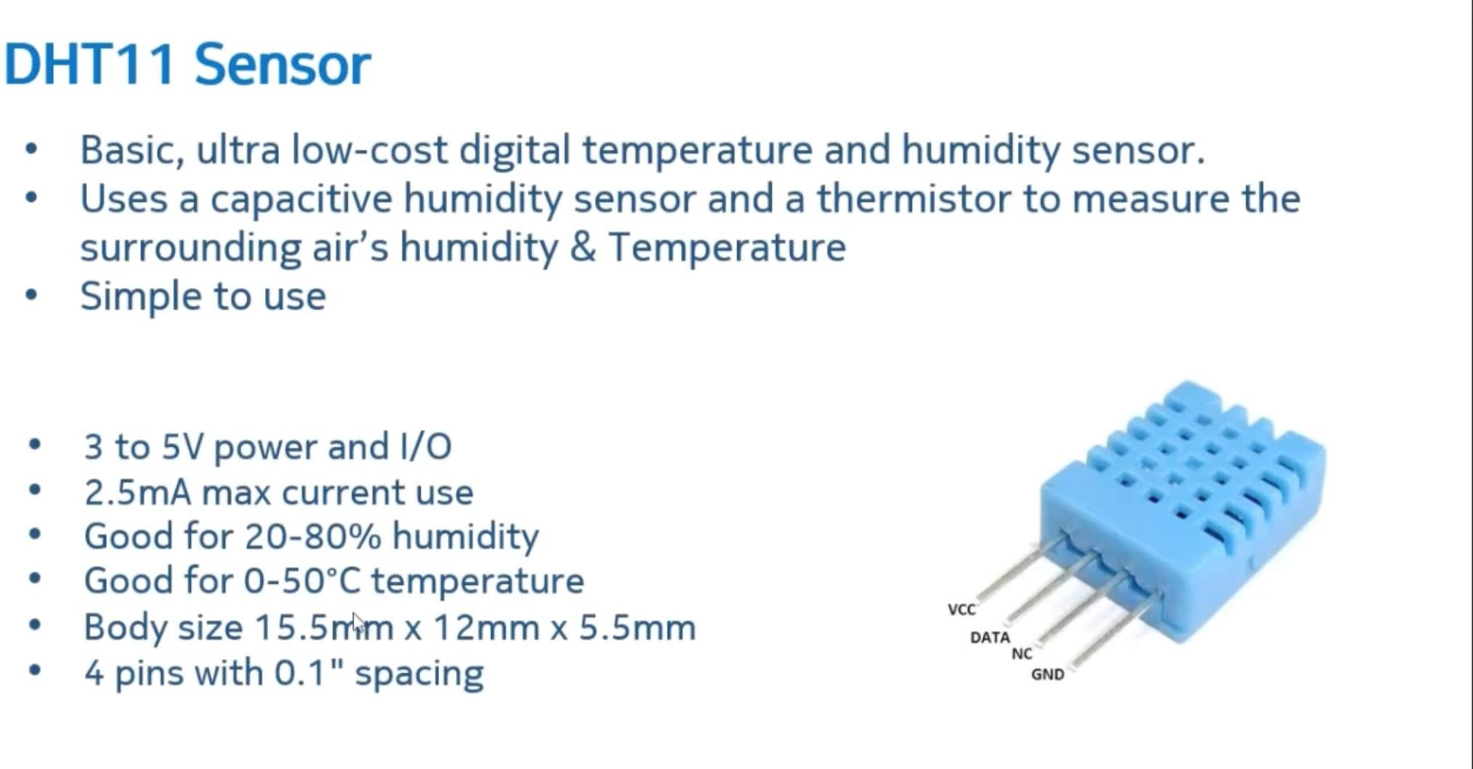

Slide 20
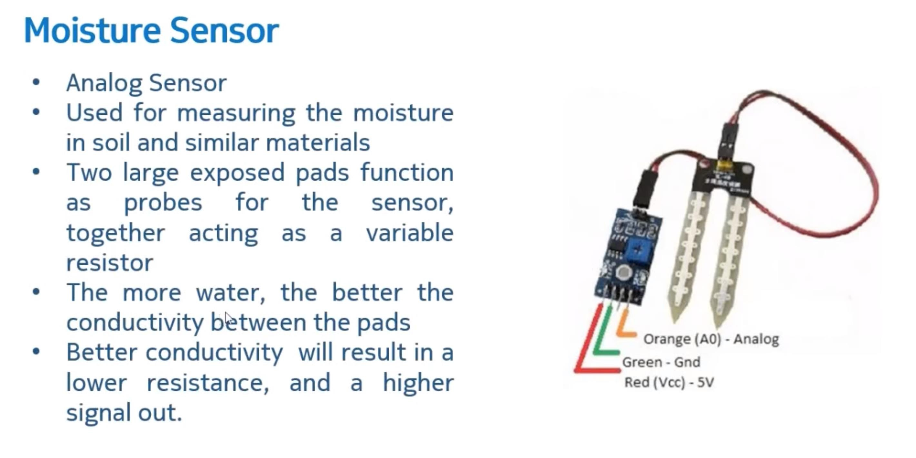

Slide 21
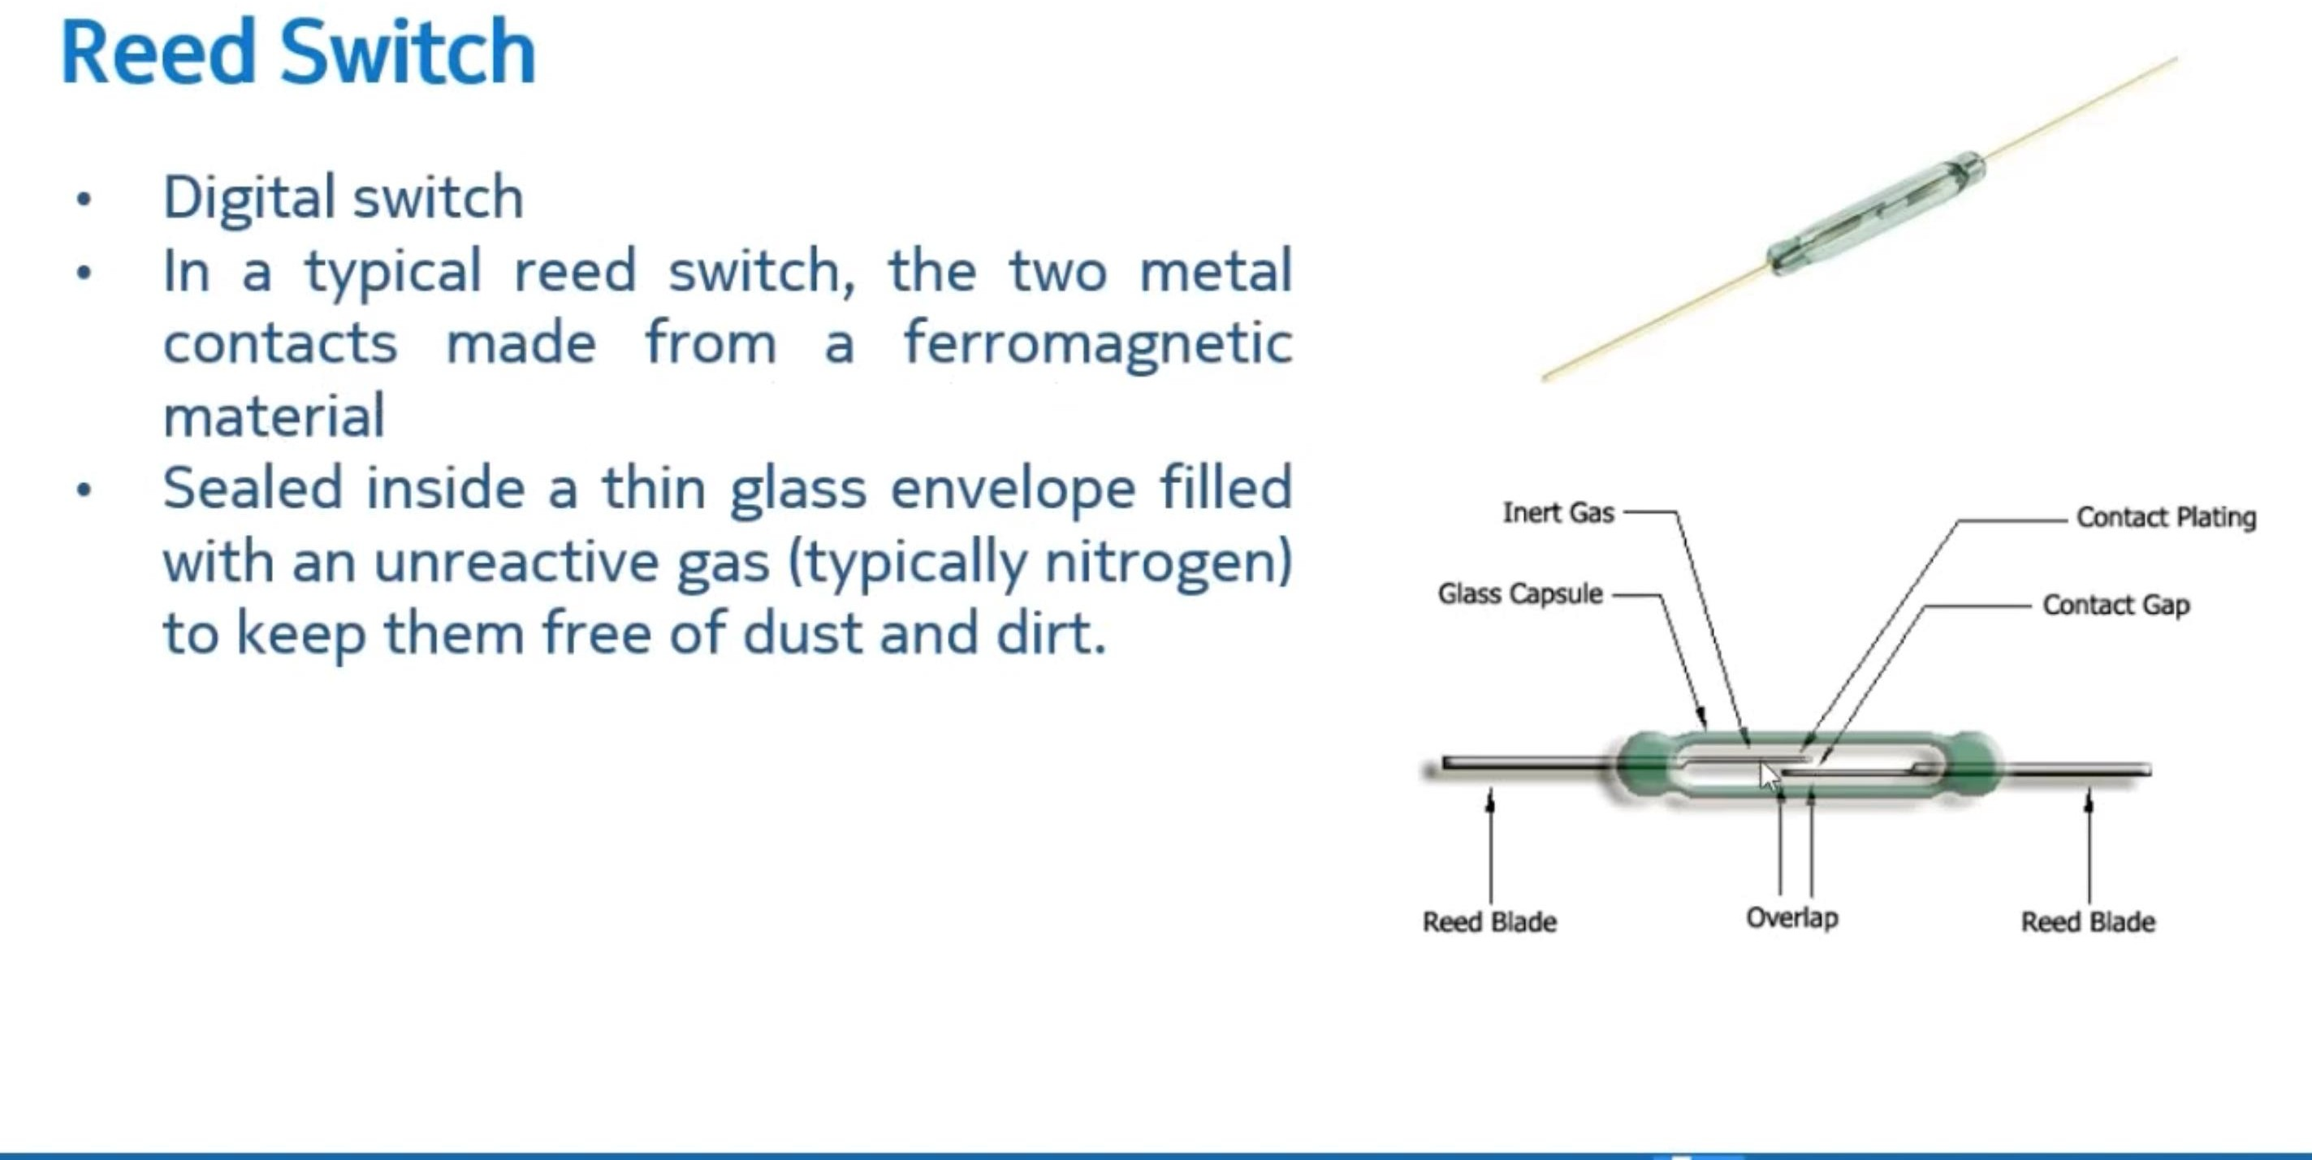

Slide 22


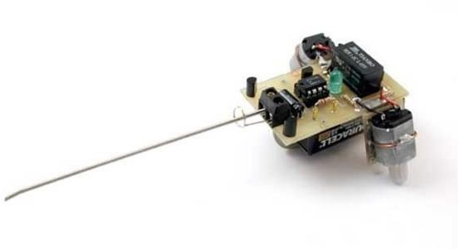
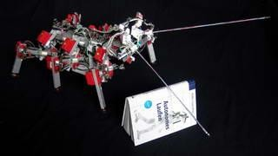
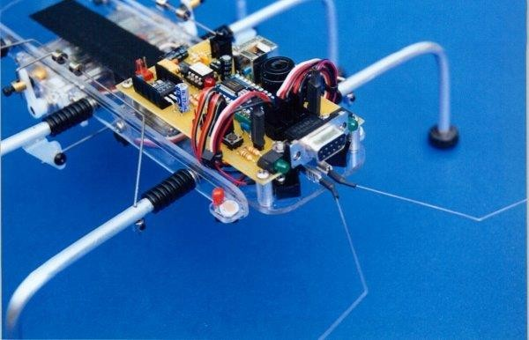

Slide 23


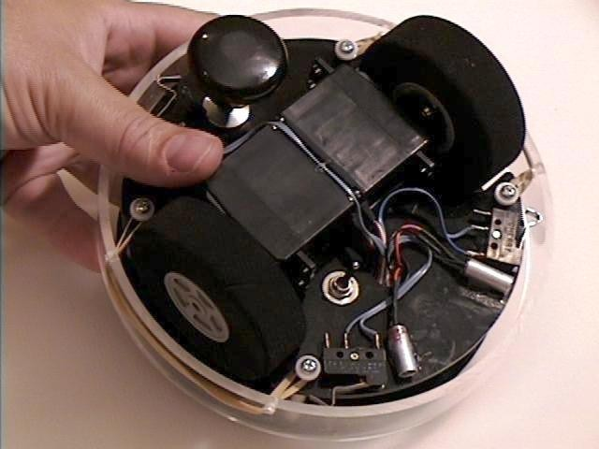
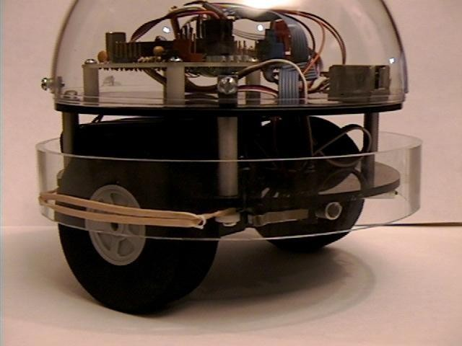
From Kevin Ross’s “Getting Started Article (SRS Website)

Slide 24

Active
Emit pulses & listen for echos
Times round trip sound travel (~1ft/mS)
Reaches far fairly beyond robot (30-50 ft)
Relatively simple, not cheap, analog output
Directional, not everything reflects sound
Noisy!!!!
Passive (sensor only)
Sensor listens to ambient sounds
Filters or scans selected frequencies
ADC measures conditioned signal amplitude
CPU performs signal analysis on what it hears

Slide 25

Passive (sensor only)
Measures elec. resistance between objects
Measure sensor that varies resistance
Use absolute or differential readings
Other ideas?

Slide 26


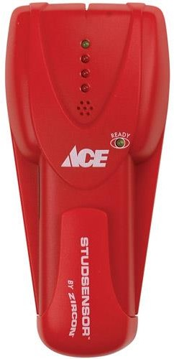
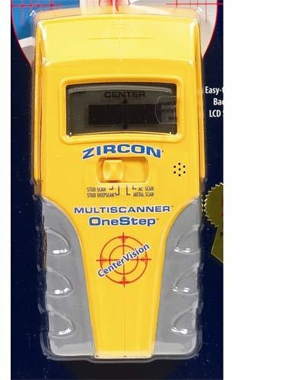
Emit an electric field below the sensor.
Nulled to a known “void” wall area.
Detect capacitance difference due to underlying material density.

Slide 27


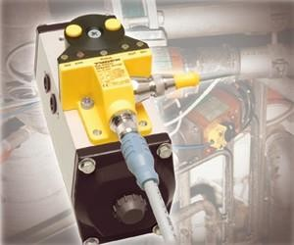
Passive
Really doesn’t work (Needs excitation)
Active (emitting)
Metals affect sensor
Current flows through inductor
Magnetic field mostly ignores non- metals
Inductance changes with metallic proximity
Short range applications (~cm or mm)

Slide 28

Active (emitting)
Camera with field of view illumination
Looks for particular reflections
Filter removes non-significant light sources
Linear array senses single axis of motion
Passive (camera only)
Scans field of interest
Looks for objects, artifacts, features of interest
Processes digital data to simplified interpretation

Slide 29
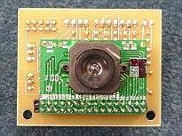
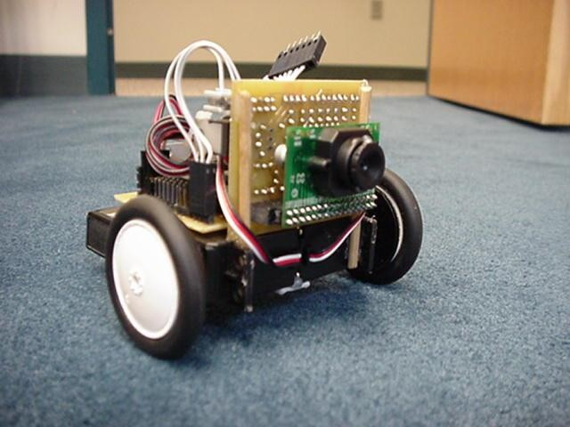
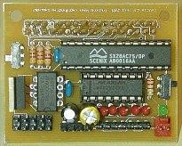
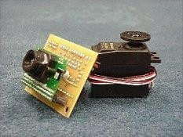
CMUCam
Linear Optical Array

Slide 30

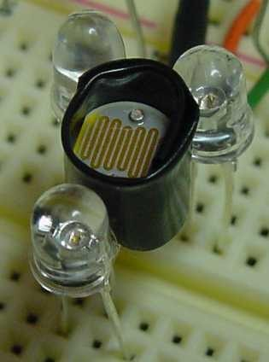
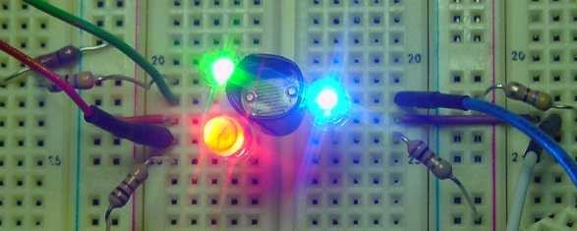
http://robotroom.com/ColorSensor.html

Slide 31

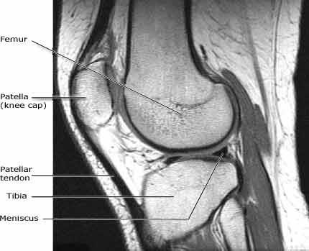
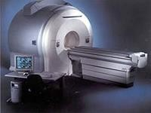
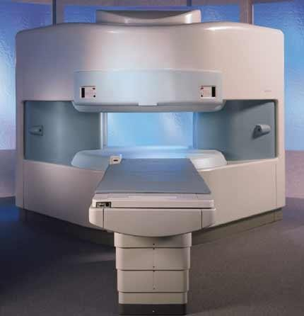
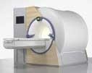
From HowStuffWorks.com & RadiologyInfo.org

Slide 32

Rate Gyros
Output proportional to angular rotation speed
Integrate to get position
Differentiate to get acceleration
DC Accelerometer
Output proportional to sine of vertical angle

Slide 33

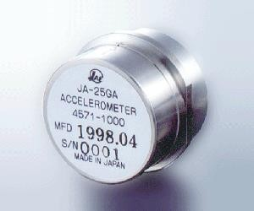
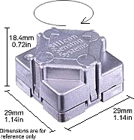
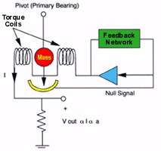
Rate Gyro – Silicon Sensing Systems Servo Accel – Sensorland.com

Slide 34

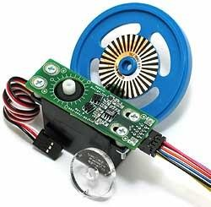
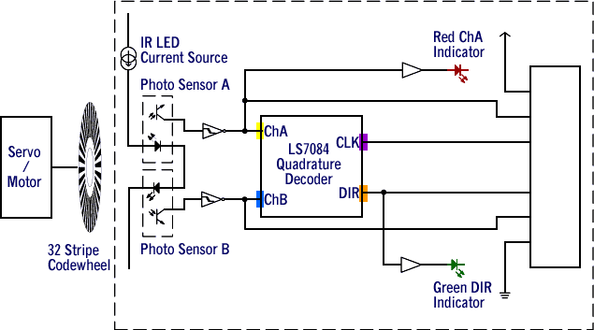
Nubotics.com, $27
Jun 98, Oct 2000 Encoder

Slide 35


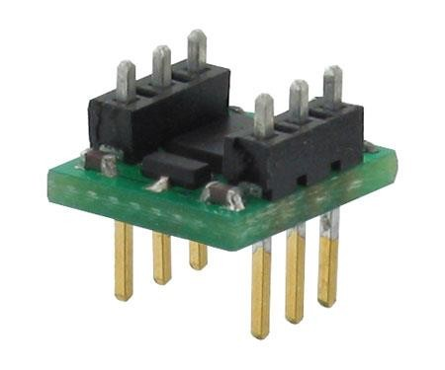
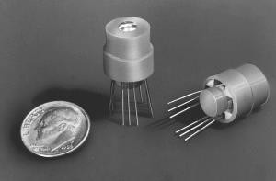
Track bearing & distance to determine position
L: Parallax.com, $30
R: Dinsmoresensors.com, $13-$37

Slide 36

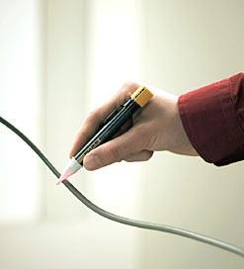
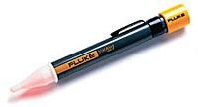
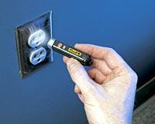
Passive – Senses electric field
Fluke Electric Field Sensors
$23 $25
$24

Slide 37

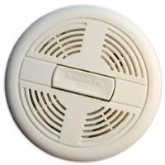
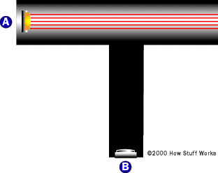
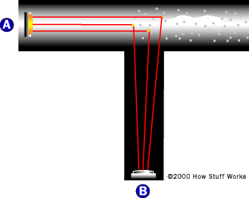
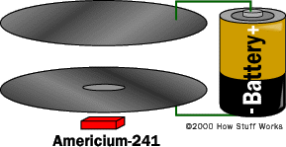
Smoke Detectors - Cheap, readily available, $5
Oxygen concentration sensors - CO, H₄S, CH_{4,} pricey
See HowStuffWorks.com

Slide 38
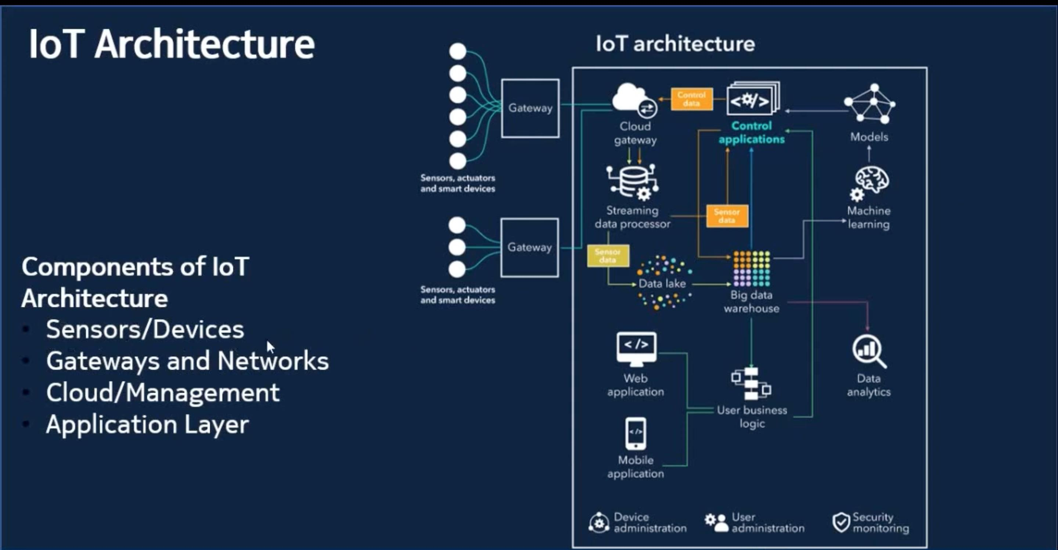

Slide 39
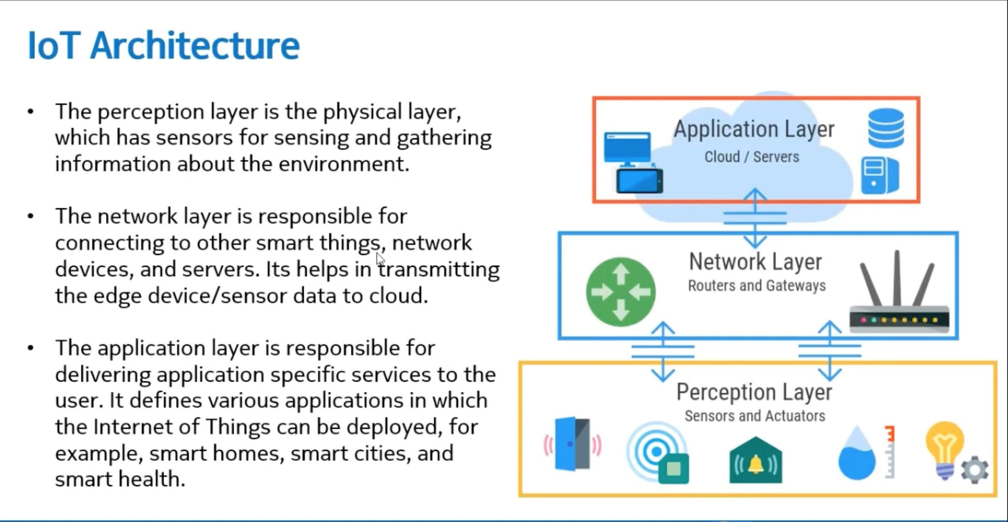

Slide 40


Slide 41


Short range radio communication
Builds on specifications laid out for earlier RFID (Radio Frequency Identification) technology²
Usually operates within a 4 cm range, but specifications allow for a range up to 20 cm²
Uses a frequency of 13.56 MHz²
Possible transfer rates are 106, 212, 424kbps¹⁵

Slide 42

 | NFC | RFID | Bluetooth | Wi-Fi
Maximum Operating Range | 10 cm | 3 m | 100 m | 100 m
Operating Frequency | 13.56 MHz | Varies¹ | 2.4 GHz | 2.4/5 GHz (802.11n)
Directional Communication | Two way | One way | Two way | Two way
Bit Rate | 106/212/ 424 Kbps | Varies¹³ | 22 Mbps | 144 Mbps
Potential Uses | e-Tickets, Credit card payment, Membership card | Tracking items, EZ- Pass | Communicat e between phones, peripheral devices | Wireless internet

Slide 43


Use phone like a contactless credit card ¹¹
Also could work as a coupon or gift card
Apple patent (lower image) shows ideas for digital concert tickets, coupons ¹⁰
Can download tickets to phone with NFC enabled computer

Slide 44

Smart posters/tags ¹²
These tags can link to relevant websites
Can be used to perform actions in applications that are NFC enabled
Could be used to download and run a guide program in a museum

